Slide 1
Binary Numbers For Beginners
By: Recarldo Brown

Slide 2
LED LAYOUT
0 = DIM
1= Bright
Binary Sequence
0 = Dim Dim Dim
1 = Dim Dim Bright
2 = Dim Bright Dim
3 = Dim Bright Bright
4 = Bright Dim Dim
5 = Bright Dim Bright
6 = Bright Bright Dim

Slide 3
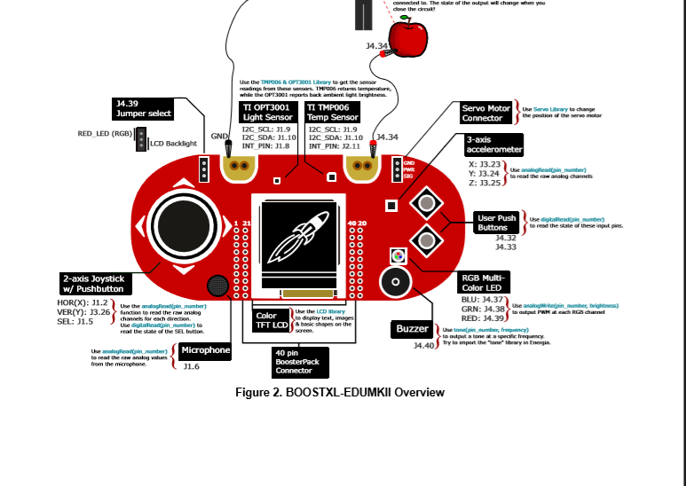

Slide 4
Values of voltage with the analog control
3.5
0.0
1.7
3.5
0.0

Slide 5
Challenges
Coding
X and Y being unable be inputted and detected at the same time by the MSP430G2 Launch Pad.

